Slide 1

Accessibility Gotchas
COMMON BARRIERS TO WEB ACCESS
AND WHAT YOU CAN DO TO FIX

Slide 2

Accessibility Gotchas: Hello World!
Michael Spellacy (He/Him)
Director of Accessibility at Radancy (Formerly TMP Worldwide)
Hails from New York City
Has 5 children! I know, right?
Restores classic arcade cabinets
Friends call him “Spell” (Hi New Friends!)

Slide 3

Accessibility Gotchas: What is Web Accessibility?
“Can we make our website accessible to blind people?”​
Here Are Stock Photos of Vince Vaughn That People Seem To Love

Slide 4
Accessibility Gotchas: What is Web Accessibility?
Web accessibility refers to the inclusive practice of making the Web usable by people of all abilities and disabilities.​
https://www.w3.org/WAI/fundamentals/accessibility-intro/

Slide 5
Accessibility Gotchas: What is Web Accessibility?
Vision​
Blindness, low vision, color-blindness​.
Motor​
Inability to use a mouse, slow response time, limited fine motor skills​.
Hearing​
Deafness and hard-of-hearing​.
Cognitive ​
Neurodiversity, learning disabilities, distractibility, inability to remember or focus on large amounts of information.​

Slide 6
Accessibility Gotchas: What is Web Accessibility?
Worldwide
20% of the population have a disability. Nearly 1 billion people!
United States​
63 Million People!
Notes:
According to CDC

Slide 7
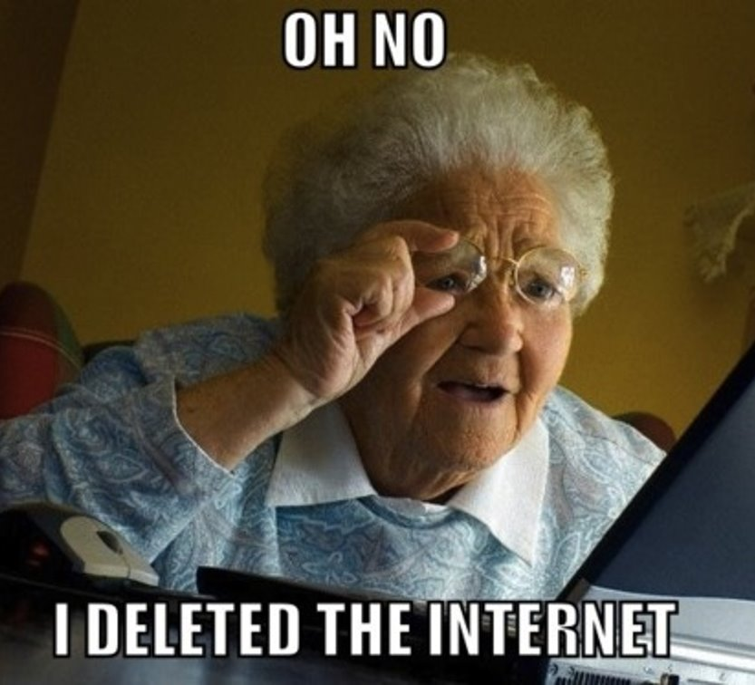
Accessibility Gotchas: What is Web Accessibility?
Aging
Notes:
17% of the the United States is 65 or older. Globally it is 9%.

Slide 8
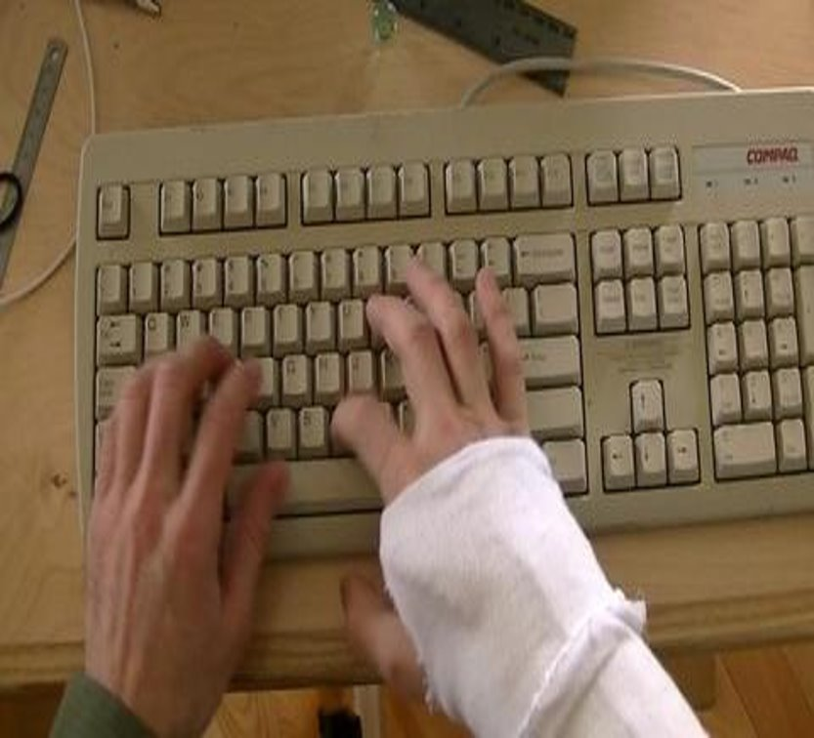
Accessibility Gotchas: What is Web Accessibility?
Temporary Barriers

Slide 9

Accessibility Gotchas: What is Web Accessibility?
Situational Barriers

Slide 10
Accessibility Gotchas: What about the law?
Section 508 mandates that all electronic and information technology used by federal government be accessible.​
Vendors must also be compliant. ​
Section 508 now embraces WCAG (Web Content and Accessibility Guidelines)
Notes:
According to CDC

Slide 11
Accessibility Gotchas: What about the law?
Private/Public sector websites have no accessibility requirements.​
Litigation is on the rise.
Civil Rights: Are digital experiences extensions of physical locations.​ (Yes.)

Slide 12
Accessibility Gotchas: WCAG
Current version: 2.1
3 levels of conformance: A, AA, and AAA
78 Success Criteria (Guidelines)
Also organized as principles: Perceivable, Operable, Understandable, and Robust (POUR)

Slide 13
Accessibility Gotchas: WCAG
Level A: Essential - If not met, certain users may not be able to read, understand, or fully operate your website.
Level AA: Ideal - Required for many government and public websites. Often seen as the gold standard in compliance.
Level AAA: Specialized - Typically reserved for websites that serve a specialized audience.

Slide 14
Accessibility Gotchas: Testing
Automated: Third-party apps and services that scan a website for barriers. Only account for about 40-50% of all known accessibility issues.
Manual: Everything else. Testing with various assistive technologies, keyboard only and manual inspection by well-versed professionals (and disabled professionals, if you are lucky).

Slide 15
Accessibility Gotchas: Zing!
Common Gotchas
(And what you can do to fix them)

Slide 16
Accessibility Gotchas: Zing!
The Most Common Gotchas:
Missing Accessible Text (Non-text Content)
Missing Captions
Missing Keyboard Access
Focus Suppression
Poor Contrast

Slide 17
Accessibility Gotchas: Missing Accessible Text
1.1.1 Non-text Content, Automated and Manual
Ensure that important images have equivalent alternative text.
Decorative images require an alt attribute, but the value can be left empty, which is also called a “null alt” (alt=””).
CSS backgrounds require no alternative text, but consider using inline image if important.
Linked images must have alternative text. Usually of a functional nature.
Complex image (graphs, infographics) descriptions are provided in context or on a separately linked page .

Slide 18
Accessibility Gotchas: Missing Accessible Text
1.1.1 Non-text Content, Automated and Manual
Question: When are images important?
Answer: When they are contextually or emotionally important to your content.

Slide 19
Accessibility Gotchas: Missing Accessible Text
1.1.1 Non-text Content, Automated and Manual
Writing Good Alternative Text:
Be concise, but descriptive.
Avoid terms like “Picture of...” or “Image of…”
Avoid using keywords. Websites are for people, not search engines.
Images with embedded text in them, should contain verbatim alternative text.

Slide 20
Accessibility Gotchas: Missing Accessible Text
1.1.1 Non-text Content, Automated and Manual
Form buttons have a descriptive value. Be explicit.
Form inputs have associated text labels (not placeholders).
Multimedia is identified via accessible text (e.g., HTML video or audio).
Inline frame (iframe) are appropriately titled and describe contents of frame.
Lesson: https://codepen.io/Spell/pen/dyOgQMe

Slide 21
Accessibility Gotchas: Missing Captions
1.2.2 Captions (Pre-recorded), Manual Test
Ensure synchronized captions are provided for non-live video.
Ensure accuracy in captions. Don’t depend on “auto-craptions”.
Use a third-party to produce captions for you. (Rev.com)
Transcripts also important. HTML can be converted to braille.
WebVTT Example: https://codepen.io/Spell/pen/dyOgQMe

Slide 22
Accessibility Gotchas: Missing Keyboard Access
2.1.1 Keyboard, Manual Test
All page functionality is available using the keyboard, unless the functionality cannot be accomplished in any known way using a keyboard (e.g., free hand drawing).
Using correct elements for the job can help here. Instead of using a div or hyperlink, use a button. Golden rule: Buttons do things; links take us places.
Lesson: https://codepen.io/Spell/pen/dyOgQMe

Slide 23
Accessibility Gotchas: Focus Suppression
2.4.7 Focus Visible
All interactive elements must have a visible outline. They aid low vision, limited mobility and power users.
All browsers have their own default outline styling. Some suck.
Outlines must never be removed unless replaced with adequate alternative.
New outline or focus state must have contrast ratio of 3:1.
Be careful that new custom outline does not match background color.
Lesson: https://codepen.io/Spell/pen/dyOgQMe

Slide 24
Accessibility Gotchas: Color Contrast
1.4.3 Contrast (Minimum)
Text and images of text have a contrast ratio of at least 4.5:1
Large text - at least 18 point (24px) or 14 point (19px) and bold - has a contrast ratio of at least 3:1
Incidental text (e.g., disabled button text) and logotypes are exempt.
Notes:
Even though the text is more discernable at 18 points and 14 points/bold, it will still fail if the color ratio is under 3:1 Mobile is also an issue as fonts sizes may be smaller there, so it is often safer to rely on a more bulletproof contrast ratio than depend on text sizes.

Slide 25
Accessibility Gotchas: Honorable Mentions
1.3.1 Info and Relationships - Semantic markup, logical headings, etc.
1.4.1 Resize Text - Page is readable (and usable) when zoomed in to 200%.
2.2.2 Pause, Stop, Hide - Avoid auto-playing or scrolling content.
2.3.1 Three Flashes or Below - Avoid content blinking more than 3x per second.
2.4.1 Bypass Blocks - Skip Links!
2.4.2 Page Titled - Ensure page has proper <title>
4.1.1 Parsing - Validate your work! Fix all major issues!

Slide 26
Accessibility Gotchas: Testing Your Work
Resources, Tools and Tips
Not sure when to include alternative text? Use the Alt Decision Tree
Automated: axe DevTools
Automated: Web Developer Toolbar
Automated: WAVE
Automated: W3C Validator
Manual: Test with your keyboard.
Manual : Listen to your work! Use a screen reader.
Manual : Colour Contrast Analyser (CCA)
Manual & Automated: Your Browser DevTools

Slide 27

Accessibility Gotchas: Overlays
Should I Use An Accessibility Overlay?

Slide 28
Accessibility Gotchas: Remember
“The power of the Web is in its universality. Access by everyone regardless of disability is an essential aspect.”
Sir Tim Berners-Lee

Slide 29

Accessibility Gotchas
Thank you!
Web: https://michaelspellacy.com
Twitter: @Spellacy
Notes:
According to CDC

